Slide 1
Difference between a Cobot and a robot
Cobot stands for Collaborative Robots.
A robot is an autonomous device which can perform tasks without the help of human beings
around it. A cobot is a robot that performs tasks in collaboration with human workers.
So presence of human being in around a robot is the differentiating factor.
So safety features are more in a Cobot since it works along with / in collaboration with
human beings than an industrial robot. Industrial robots are normally caged, but not cobots.
Human beings can work along with cobots, not with industrial robots.

Slide 2
Industrial robots are 1) typically large, and fixed equipment 2) designed for high-volume, extremely high-accuracy, and high-speed production. 3) Because of the speed of the robot’s arm movement, industrial robots can present safety risks to human workers, so they usually require safety measures such as a cage to keep humans out of the robot’s work envelope.
Cobots
1) are not fixed equipment type. The end tool can be changed depending upon the task. Can be easily redeployed.
2) ideal for manufacturers with low-volume, high-mix production. Used when someone needs to safely automate processes alongside human workers.
3) There are no safety risks to human operators who work alongside the cobots.

Slide 3
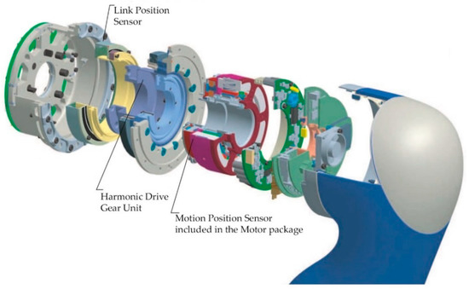
CoBot joint with motor and harmonic drive
Harmonic drives (gears) are recently being used in place of planetary gear systems. Such gear system is very compact, light
weight and having large reduction capacity. So this makes the motors used in cobots light weight, occupying less space. For
example, If I want 40 Nm torque, if I purchase a motor having planetary geared system, its weight will be around 4-5 kg. If I use
A BLDC with harmonic drive, it will be less than 1 kg. But the cost of such a motor will be around 1.2 lakh compared to 20k or
40k for servo motors with planetary gear heads.

Slide 4
Sensors in a COBOT
The most common sensors used in a COBOT are torque, force, optical, position, and temperature sensors
Role of torque sensor These sensors are mounted at all joints.
Torque sensors are used for two purposes. (1) In cobots the torque required at the joints is limited. It is designed to be safe. In an Industrial robot, if the pay load is higher than the designed one, the motor can draw higher current from the controller and perform the task (assumed that the motor is of higher capacity than the load). But in case of a COBOT, it is not possible. If you put a higher payload than the designed one, the torque sensor will detect how much torque is being applied by the motor and it will stop the operation.

Slide 5
(2) When a torque sensor is used in each arm joint, it can detect if any external force or torque is exerted on the arm. This happens when a human being accidentally hit by cobot. Presence of torque sensor enables a very fast stop on contact. This will prevent potential damage to the human being/ cobot. This is one of the important safety features of cobot.
Role of Force sensor: (1)A force sensor is mounted on the end-effecter of the gripper of a cobot. It senses the item to be gripped and accordingly directs the EE to apply force, else the item may get damaged.
(2) It also acts as a touch sensor for the cobot. For ensuring surface finish, this sensor can be used and accordingly it can engage other machine tools for fine surface finish.

Slide 6
Role of Optical sensor: Optical 3D measurement sensor, measures the dimensions of the products even under production conditions. This makes cobots ideal for verifying the surface finish and dimensional accuracy of workpieces in existing production environments.
Role of position sensor: (1) Positional sensors are for angular, motion, and distance measurement. A cobot or robot's arm, for example, will employ many positional sensors in joints, flanges, limbs and arms, motors, and slip rings. They are also present in the grippers, tools, and end effectors. One use of these sensors is to find out exactly where the end-effector is.
(2) One more application of position sensor is to measure the distance with ultrasonic sensor. For example, when a cobot detects that someone has come close to it, the speed of its operation goes down. This is done by ultrasonic position sensor mounted on the cobot.

Slide 7
Major manufacturers of COBOTs
Role of temperature sensor
Temperature sensor helps the robot to adapt to the environment. For example, for a desert environment or glacier environment.
FANUC, Yaskawa, ABB, KUKA,
Universal Robots, Precise Automation
Techman Robot, AUBO Robotics
Rethink Robotics, Doosan Robotics
Approximate cost of a COBOT
UR 5 is around INR 28lakh , 6 axis
Doosan 10 kg 20 klakh

Slide 8
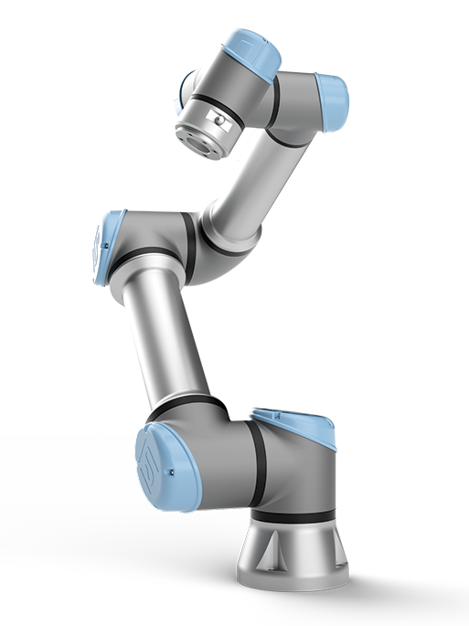
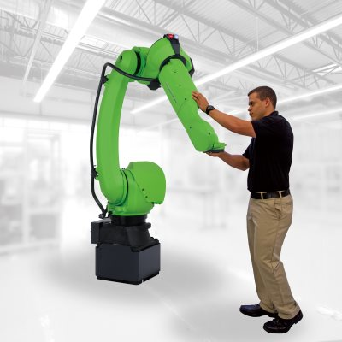
Fanuc 35 KG PAYLOAD COBOT
UR5 - 5 KG PAYLOAD COBOT from Universal Robotics

